Slide 1



Feature Extraction for Emotion Recognition using Facial Videos and Physiological Signals
Research Topic:
Presented by:
Bhargav Ramudu Manam
M.Sc. Data Science & Artificial Intelligence
Supervised by:
Laura Ferrari
Valeriya Strizhkova
STARS Team, INRIA

Slide 2
Contents:
Introduction
State-of-the-art
Feature Extraction Methodology
Conclusion

Slide 3
Introduction
Emotion Recognition
Identifying and classifying the emotional state of an individual through certain cues (modalities) into various categories (happy, sad, neutral, . . . ), by means of an algorithm.
Modalities
Videos
Physiological/ Bio Signals

Slide 4
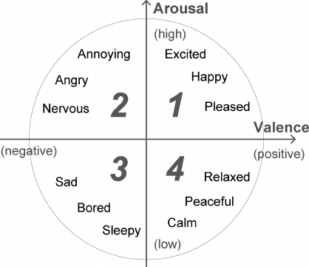
Introduction
Assessment
Valence: extent to which the given emotion is positive or negative.
Arousal: the intensity (strength) of the given emotion.
Source: https://tinyurl.com/4v7uj4x4

Slide 5
OBJECTIVE
Perform State-of-the-art (SOA)
Select/ Propose a Feature Extraction Methodology based on SOA

Slide 6
State-of-the-art
Experimental setup
MAHNOB (Soleymani et al, 2012)
DEAP (Koelstra et al, 2012)

Slide 7
State-of-the-art
Abbreviation | Signal Name | Usage
EEG | Electroencephalogram | Measure the brain activity
ECG/ PPG | Electrocardiogram/ Photoplethysmogram | Heart Rate (HR) and Heart Rate Variability (HRV)
EOG | Electrooculogram | Useful in obtaining eye movement and blinks
EMG | Electromyogram | Detect neurological activity through body muscles
EDA/ GSR | Electrodermal activity/ Galvanic Skin Response | Stress monitoring and lie detection
Physiological Signals used in MAHNOB and DEAP databases

Slide 8
State-of-the-art
Dataset | MAHNOB (Soleymani et al, 2012) | DEAP (Koelstra et al, 2012)
# Subjects | 27 | 32
# Sessions per subject | 20 | 40
Session length | Varied (34.9 - 117 sec) | Fixed (60 sec)
Induced or Natural Emotion | Induced | Induced
Posed or Spontaneous Emotion | Spontaneous | Spontaneous
Modalities | Audio (2 channels), Visual (6 views), EEG (32 channels), ECG (3 channels), GSR, Respiration Amplitude, Skin Temperature, Eye-Gaze data | EEG(32 channels), PPG, GSR, EOG (4 channels), EMG (4 channels), Visual (for 22 subjects), Respiration Amplitude, Skin Temperature
Sampling rate for bio-signals | 256 Hz | 256 Hz
Quantities assessed | Arousal, Valence, Emotion, Dominance, Predictability | Arousal, Valence, Dominance, Liking, Familarity
Rating scales | Discrete scale: 1 - 9 | Continuous scale: 1 - 9, Discrete scale: 1 - 5 (Familarity)
Assessment | Self-Assessment | Self-Assessment
Baseline data (Fixation cross) | 30 sec | 5 sec
Overview of MAHNOB and DEAP databases

Slide 9
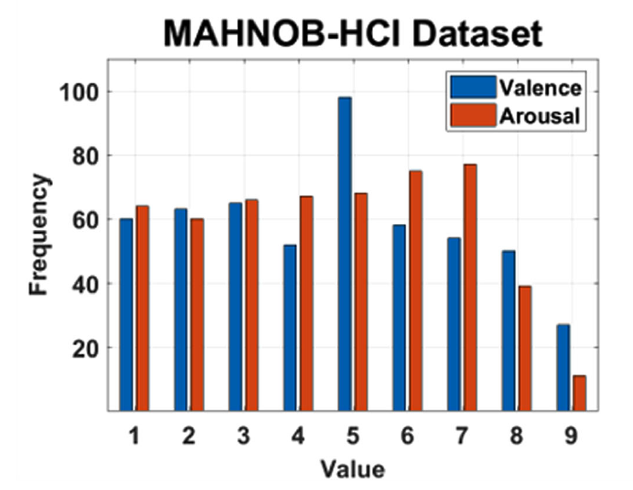
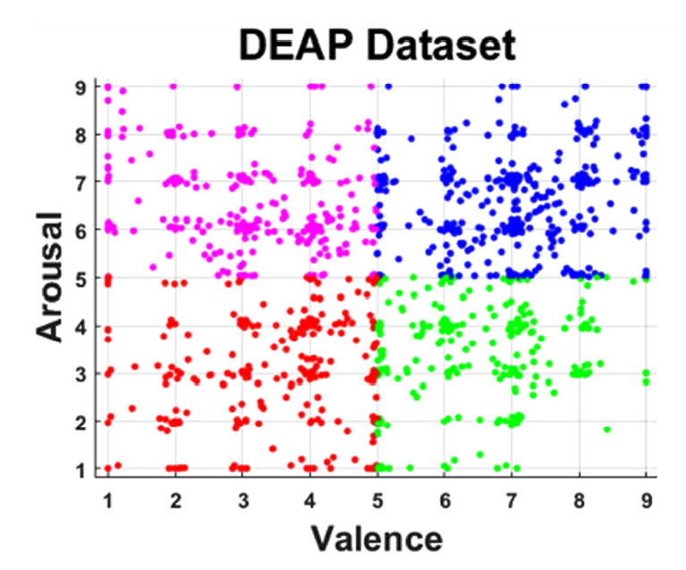
State-of-the-art
Distribution of Valence and Arousal in MAHNOB and DEAP databases (Siddharth et al, 2019)

Slide 10
State-of-the-art: MAHNOB
Reference | Modality | Extracted Features | Accuracy (%)
 | Modalities: EEG, ECG, GSR, Respiration (R), Visual (V), Skin Temperature (ST), Eye gaze | EEG, ECG, GSR, Respiration (R), Visual (V), Skin Temperature (ST), Eye gaze | Arousal, Valence
(Soleymani et al, 2012) | All | Hand crafted features and selection through ANOVA test | 46.2, 45.5 (3 classes)
(Soleymani et al, 2012) | EEG | Hand crafted features and selection through ANOVA test | 52.4, 57.0 (3 classes)
(Soleymani et al, 2012) | Eye gaze | Hand crafted features and selection through ANOVA test | 63.5, 68.8 (3 classes)
(Soleymani et al, 2012) | EEG, Eye gaze | Hand crafted features and selection through ANOVA test | 67.7, 76.1 (3 classes)
(Koelstra et al, 2013) | EEG | Hand crafted features and selection through ICA | 66.0, 71.5
(Koelstra et al, 2013) | V | Features based on Action Units (AUs) and selection through ICA | 65.0, 64.5
(Koelstra et al, 2013) | EEG, V | Hand crafted features, AUs and selection through ICA | 68.0, 72.5
(Siddharth et al, 2019) | EEG | PSD, CE, from power spectrum images using pre-trained VGG-16 and selection through PCA | 80.42, 80.77
(Siddharth et al, 2019) | ECG | HR, HRV, from spectrogram images using pre-trained VGG-16 and selection through PCA | 78.76, 78.76
(Siddharth et al, 2019) | GSR | Statistical, from spectrogram images using pre-trained VGG-16 and selection through PCA | 81.84, 78.98
(Siddharth et al, 2019) | V | Based on AUs (each frame) and statistical (all frames) | 82.15, 83.04
(Siddharth et al, 2019) | V | Using pre-trained VGG-16 and selection through PCA | 81.57, 85.13
(Siddharth et al, 2019) | EEG, ECG, GSR | Fusion of individual features mentioned above | 80.61, 80.36
(Siddharth et al, 2019) | EEG, V | Fusion of individual features mentioned above | 82.93, 85.49
The first four results from (Soleymani et al, 2012) are based on 3-class classification, whereas all the remaining results are for binary classification.
ANOVA: Analysis of Variance, ICA: Independent Component Analysis, PSD: Power Spectral Density, CE: Conditional Entropy, HR: Heart Rate, HRV: Heart Rate Variability, PCA: Principal Component Analysis
VGG-16 (Simonyan et al, 2014) is a 16 layer deep CNN Model trained on ImageNet (J. Deng et al, 2009).

Slide 11
State-of-the-art: DEAP
Reference | Modality | Extracted Features | Accuracy (%)
 | Modalities: EEG, PPG, GSR, EOG, Visual (V) |  | Arousal, Valence
(Li et al, 2015) | EEG | High level features through 2 layer DBN | 64.3, 58.4
(Siddharth et al, 2019) | EEG | PSD, CE, from power spectrum images using pre-trained VGG-16 and selection through PCA | 72.58, 71.09
(Siddharth et al, 2019) | PPG | HR, HRV, from spectrogram images using pre-trained VGG-16 and selection through PCA | 71.09, 70.86
(Siddharth et al, 2019) | GSR | Statistical, from spectrogram images using pre-trained VGG-16 and selection through PCA | 71.64, 70.70
(Siddharth et al, 2019) | V | Based on AUs (each frame) and statistical (all frames) | 72.21, 71.08
(Siddharth et al, 2019) | V | Using pre-trained VGG-16 and selection through PCA | 74.47, 72.28
(Siddharth et al, 2019) | EEG, V | Fusion of individual features mentioned above | 74.13, 73.94
(Siddharth et al, 2019) | EEG, V | Fusion of individual features mentioned above (by taking mean PSD images and facial images per every sec) and then passing them through a LSTM to account for time dependency | 78.34, 79.52
(Siddharth et al, 2019) | EEG, PPG, GSR | Fusion of individual features mentioned above | 73.05, 71.87
(Liu et al, 2016) | EEG, EOG | High level features using BDAE | 80.5, 85.2
(Yin et al, 2017) | All | Hand crafted features and passed through a SAE network separately and fused in the end | 84.18, 83.04
(Tang et al, 2017) | All | DE and Time-Domain and dimension reductionality using a BDDAE network | 83.23, 83.82
All the results are for binary classification.
PSD: Power Spectral Density, CE: Conditional Entropy, DBN: Deep Belief Networks, HR: Heart Rate, HRV: Heart Rate Variability, PCA: Principal Component Analysis, DE: Differential Entropy, BDAE: Bi-modal Auto Encoder, BDDAE: Bimodal Deep Denoising Auto Encoder.
SAE: Stacked Auto Encoder, VGG-16 (Simonyan et al, 2014) is a 16 layer deep CNN Model trained on ImageNet (J. Deng et al, 2009).

Slide 12
State-of-the-art
Inferences
In general, Multi-modal models classify arousal and valence better than those using single-modality.
Overall, for a given modality, classification using visual modality achieves higher accuracy followed by EEG.
Single modality ER model can perform better than MER model if the modalities are not chosen well.
Models using DL based feature extraction strategies fare better than those using rule based or hand crafted features, though the difference is not significantly large.
Following same feature extraction methodology on different databases does not yield similar accuracies. (poor generalization)

Slide 13
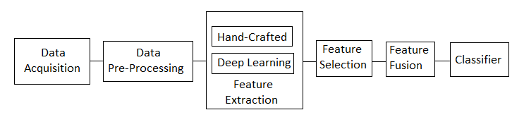
Feature Extraction Methodology

Slide 14
Feature Extraction Methodology
Data Pre-Processing
Videos:
Segmentation
Face detection
Viola-jones algorithm (Viola et al, 2001)
OpenCV (Itseez: The OpenCV Reference Manual, 2.4.9.0 edn. (April 2014))
Resolution

Slide 15
Feature Extraction Methodology
Data Pre-Processing
Videos:
Segmentation: the input videos has certain sampling rate (frames per second) at which an image frame is generated. This should be set taking into considerations on both computation cost and sampling rate of other modalities (for parallel or combined feature extraction)
Face detection: image from each frame is processed to highlight or crop into the region containing only face for better feature extraction. Popularly, Viola-jones (20) algorithm or OpenCV (7) are used for face detection.
Resolution: each image is resized according to the input dimensions of the model.

Slide 16
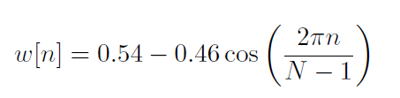
Feature Extraction Methodology
Data Pre-Processing
Physiological signals:
Filtering
Segmentation
Hamming:
The Hamming window function is given by:
where n is the sample index and N is the length of the window.
Discrete Fourier transform (DFT): used to convert the signal from time domain to frequency domain.
Discrete Wavelet transform (DWT): used to remove noise from signals.

Slide 17
Feature Extraction Methodology
Data Pre-Processing
Physiological signals:
Filtering and Emphasizing: unnecessary frequencies and artifacts occurred during data collection can be removed by applying low-pass, high-pass and band-pass filters respectively. Consequently, filtering can be used to emphasize the high frequencies as they usually have low amplitudes. This is beneficial during Fourier transform computation.
Segmentation: similar to videos, bio signals are divided into windows (frames) and the length of the window is chosen as per requirement (keeping in mind the frame rate of videos). Consecutive windows are overlapped (around 50%) so that spectral information is not lost (non-stationary signals). Additionally, signal within each window is assumed to be stationary.

Slide 18
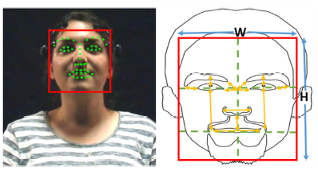
Feature Extraction Methodology
Feature Extraction
Hand crafted features:
Videos
Facial landmarks: Chehra algorithm (Asthana et al, 2014)
Siddharth et al, 2019
Facial Action Coding System (Ekman et al, 1978) or Action Units (AUs): the features obtained from facial landmarks for a given session can be used to determine high level features called Action Units based on (Ekman et al, 1980) or gestures (Caridakis et al, 2011) (lip, eye, head position/movements). In turn, these AUs or gestures are associated with a certain emotion (Kleinsmith et al, 2013).
Emotion | Action units
Happiness | 6+12
Sadness | 1+4+15
Surprise | 1+2+5B+26
Fear | 1+2+4+5+7+20+26
Anger | 4+5+7+23
Disgust | 9+15+17
Contempt | R12A+R14A
https://en.wikipedia.org/wiki/Facial_Action_Coding_System

Slide 19
Feature Extraction Methodology
Feature Extraction
Hand crafted features:
Videos
Facial landmarks: the images in each frame are used for detecting relevant points on the face. These points are typically surrounded around eyes, nose and mouth. These points are then used to calculate certain distances (features) such as distances between eyes, lips and nose, etc,.
Facial Action Coding System (FACS) or Action Units (AUs): the features obtained from facial landmarks for a given session can be used to determine high level features called Action Units (6) based on (5)(AUs) or gestures (3) (lip, eye, head position/movements). In turn, these AUs or gestures are associated with a certain emotion (8). Chehra (1) is a SOA algorithm to extract AUs from facial landmark features.

Slide 20
Feature Extraction Methodology
Feature Extraction
Hand crafted features:
Physiological Signals
Time domain (TD)
Energy
Zero Crossing Rate
Frequency or spectral domain (FD)
Power Spectral Density (PSD), Spectral Power
Time-frequency domain (TFD):
Spectrograms
Statistical features

Slide 21
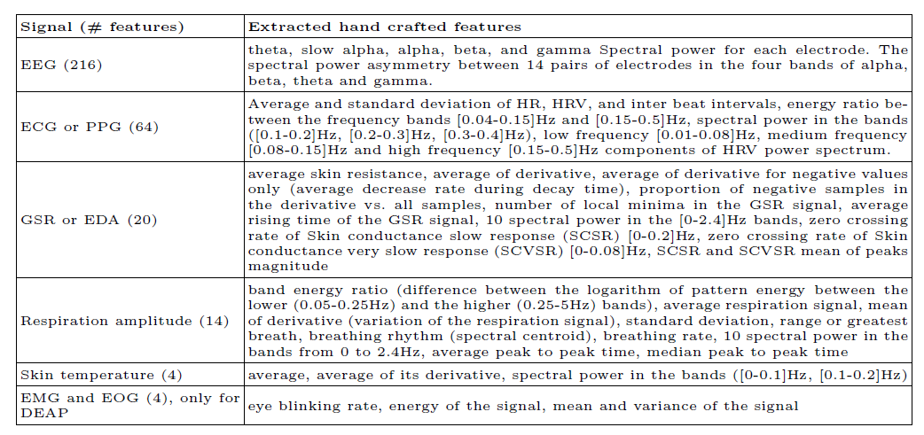
Feature Extraction Methodology
Feature Extraction
Hand crafted features:
Hand crafted features extracted by the original authors of MAHNOB(18) and DEAP (9) databases

Slide 22
Feature Extraction Methodology
Feature Extraction
Deep learning features
CNN, RNN, LSTM, etc,.
“Facial Expression Recognition using Convolutional Neural Networks: State of the Art” Christopher Pramerdorfer, Martin Kampel, 2016
Class activation maps (Do we still need AUs?)
Class Activation Maps (Anatoli de Bradke et al, 2018)

Slide 23
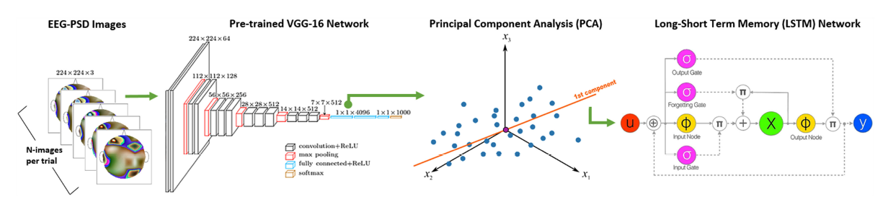
Feature Extraction Methodology
Feature Extraction
Hybrid features:
Spatial features (EEG)

Slide 24
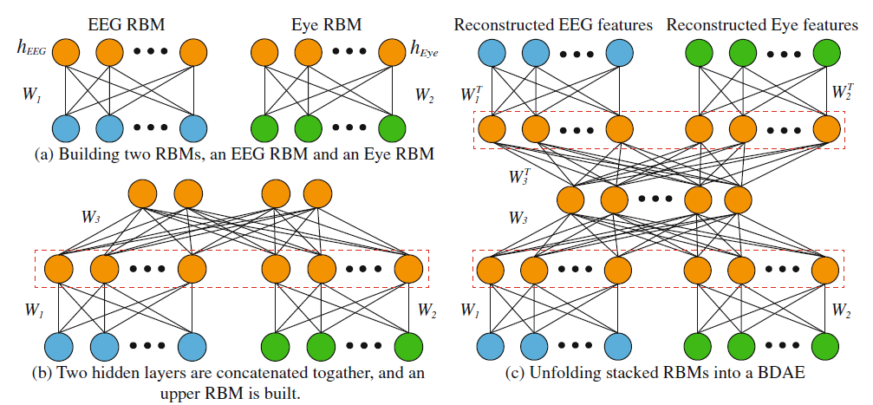
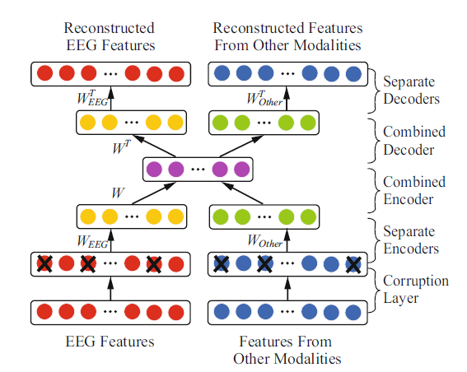
Feature Extraction Methodology
Feature Extraction
Hybrid features
Structure of BDDAE network (Tang et al, 2017)
The structure of BDAE (Liu et al, 2016)

Slide 25
Feature Extraction Methodology
Feature Selection
Statistical tests
Pearson correlation coefficient
Mutual Information
Feature Transformation/ Reduction
Principal Component Analysis (PCA)
Auto-Encoders (AE)

Slide 26
Feature Extraction Methodology
Feature Fusion
Feature level
Interpretation
Decision level
Choice of classifiers

Slide 27
Feature Extraction Methodology
Feature Fusion
Feature level
Interpretation
Decision level
Choice of classifiers
Classifier
LDA, QDA, SVM, MLP, etc,.
The authors in (Lotte et al, 2017) discuss several such classifiers for ER using EEG and presented guidelines for selection of a classifier.

Slide 28
Conclusion
ER using MM is more accurate and model performance depends on feature extraction strategies.
Model based to model free (DL)
FE and FS techniques are more relevant in the context of classical ML models than the DL models
Additionally, there are several methods which are in-between (hybrid) trying to take the advantage of both approaches.
Transfer Learning for better generalization and real-time ER

Slide 29
Conclusion & Future Work
As a future work, the proposed methodology can be carried out on databases DEAP and MAHNOB.
Also, due to similarity of these databases it can be interesting to train and test models by combining several databases and the resultant model can be used to make predictions or used as a pre-trained model on any other similar database (transfer learning). This can result in a much more generalized model that can be deployed real-time.
Finally, as it was reported that DL frameworks were only performing marginally better than the traditional methods, there is a need to look into the architectures of the existing DL models and modify them or design a better model that can capture the maximum information from the input modalities and can extract rich features.

Slide 30

Thank you

